Slide 1
Artificial Intelligence:Past, Present & Future
School of AI
https://www.meetup.com › Kanpur School of AI
Hammad Mashkoor
@Hammad_Lari

Slide 2
Conscious killer robots to 'bide their time' to ENSLAVE humans
Elon Musk says AI could doom human civilization. Zuckerberg disagrees. Who's right?

Slide 3
A recent survey of 50 Nobel Laureates ranked the climate, population rise, nuclear war, disease, selfishness, ignorance, terrorism, fundamentalism, and Trump as bigger threats to humanity than AI.

Slide 4
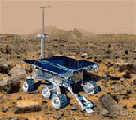

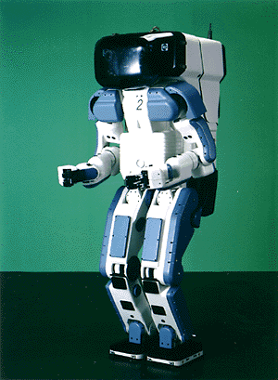

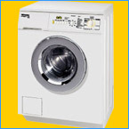
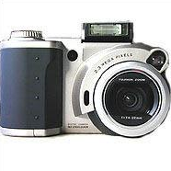

Why study AI?
Search engines
Science
Medicine/
Diagnosis
Labor
Appliances
What else?

Slide 5
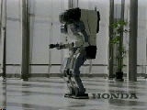
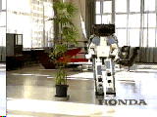
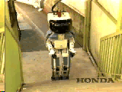
Honda Humanoid Robot
Walk
Turn
http://world.honda.com/robot/
Stairs

Slide 6
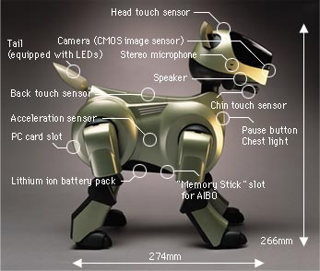
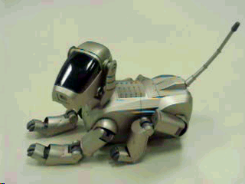
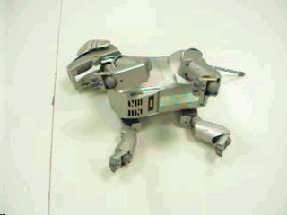
Sony AIBO
http://www.aibo.com

Slide 7
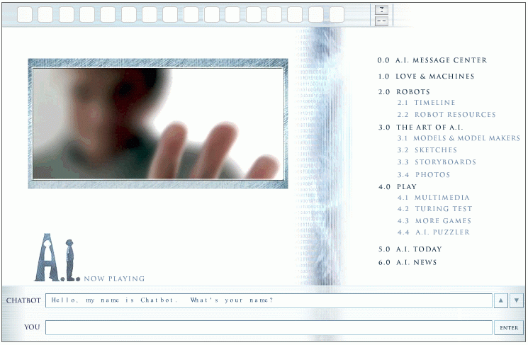
Natural Language Question Answering
http://aimovie.warnerbros.com
http://www.ai.mit.edu/projects/infolab/

Slide 8
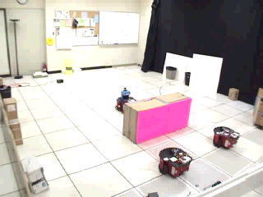
Robot Teams
USC robotics Lab

Slide 9
What is Intelligence ?
Dictionary.com
capacity for learning, reasoning, understanding, and similar forms of mental activity;
-forms of mental activity
Are Humans Intelligent?
Are Humans Always Intelligent?
Machine build-Replicating humans

Slide 10
What is AI?
The exciting new effort to make computers thinks … machine with minds, in the full and literal sense”
(Haugeland 1985)
“The study of mental faculties through the use of computational models”
(Charniak et al. 1985)
“The art of creating machines that perform functions that require intelligence when performed by people” (Kurzweil, 1990)
A field of study that seeks to explain and emulate intelligent behavior in terms of computational processes” (Schalkol, 1990)
Systems that think like humans
Systems that think rationally
Systems that act like humans
Systems that act rationally
Notes:
How do you know - How you think?
Suppose I Say this a table thinks.Wooden Brain. Can I Ever Know?
Table has no way to communicate. so Assessing it by a act-experiment.

Slide 11
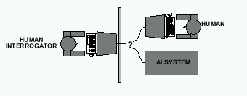
Acting Humanly: The Turing Test
Alan Turing's 1950 article Computing Machinery and Intelligence discussed conditions for considering a machine to be intelligent
“Can machines think?” ←→ “Can machines behave intelligently?”
The Turing test (The Imitation Game): Operational definition of intelligence.
Notes:
1950 World War Ended.

Slide 12
Acting Humanly: The Turing Test
Computer needs to possess: Natural language processing, Knowledge representation, Automated reasoning, and Machine learning
Are there any problems/limitations to the Turing Test?

Slide 13
What tasks require AI?
“AI is the science and engineering of making intelligent machines which can perform tasks that require intelligence when performed by humans …”
What tasks require AI?

Slide 14
What tasks require AI?
Tasks that require AI:
Solving a differential equation
Brain surgery
Inventing stuff
Playing Jeopardy
Playing Wheel of Fortune
What about walking?
What about grabbing stuff?
What about pulling your hand away from fire?
What about watching TV?
What about day dreaming?

Slide 15
Acting Humanly: The Full Turing Test
Alan Turing's 1950 article Computing Machinery and Intelligence discussed conditions for considering a machine to be intelligent
“Can machines think?” ←→ “Can machines behave intelligently?”
The Turing test (The Imitation Game): Operational definition of intelligence.
Computer needs to posses:Natural language processing, Knowledge representation, Automated reasoning, and Machine learning
Problem: 1) Turing test is not reproducible, constructive, and amenable to mathematic analysis. 2) What about physical interaction with interrogator and environment?
Total Turing Test: Requires physical interaction and needs perception and actuation.

Slide 16
Acting Humanly: The Full Turing Test
Problem:
1) Turing test is not reproducible, constructive, and amenable to mathematic analysis.
2) What about physical interaction with interrogator and environment?

Slide 17
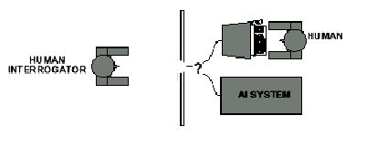
Acting Humanly: The Full Turing Test
Problem:
1) Turing test is not reproducible, constructive, and amenable to mathematic analysis.
2) What about physical interaction with interrogator and environment?
Trap door

Slide 18
What would a computer need to pass the Turing test?
Natural language processing: to communicate with examiner.
Knowledge representation: to store and retrieve information provided before or during interrogation.
Automated reasoning: to use the stored information to answer questions and to draw new conclusions.
Machine learning: to adapt to new circumstances and to detect and extrapolate patterns.

Slide 19
What would a computer need to pass the Turing test?
Vision (for Total Turing test): to recognize the examiner’s actions and various objects presented by the examiner.
Motor control (total test): to act upon objects as requested.
Other senses (total test): such as audition, smell, touch, etc.

Slide 20
Thinking Humanly: Cognitive Science
1960 “Cognitive Revolution”: information-processing psychology replaced behaviorism
Cognitive science brings together theories and experimental evidence to model internal activities of the brain
What level of abstraction? “Knowledge” or “Circuits”?
How to validate models?
Predicting and testing behavior of human subjects (top-down)
Direct identification from neurological data (bottom-up)
Building computer/machine simulated models and reproduce results (simulation)

Slide 21
Thinking Rationally: Laws of Thought
Aristotle (~ 450 B.C.) attempted to codify “right thinking” What are correct arguments/thought processes?
E.g., “Socrates is a man, all men are mortal; therefore Socrates is mortal”
Several Greek schools developed various forms of logic: notation plus rules of derivation for thoughts.

Slide 22
Thinking Rationally: Laws of Thought
Problems:
Uncertainty: Not all facts are certain (e.g., the flight might be delayed).
Resource limitations:
Not enough time to compute/process
Insufficient memory/disk/etc
Etc.

Slide 23
Acting Rationally: The Rational Agent
Rational behavior: Doing the right thing!
The right thing: That which is expected to maximize the expected return
Provides the most general view of AI because it includes:
Correct inference (“Laws of thought”)
Uncertainty handling
Resource limitation considerations (e.g., reflex vs. deliberation)
Cognitive skills (NLP, AR, knowledge representation, ML, etc.)
Advantages:
More general
Its goal of rationality is well defined

Slide 24
How to achieve AI?
How is AI research done?
AI research has both theoretical and experimental sides. The experimental side has both basic and applied aspects.
There are two main lines of research:
One is biological, based on the idea that since humans are intelligent, AI should study humans and imitate their psychology or physiology.
The other is phenomenal, based on studying and formalizing common sense facts about the world and the problems that the world presents to the achievement of goals.
The two approaches interact to some extent, and both should eventually succeed. It is a race, but both racers seem to be walking. [John McCarthy]

Slide 25
Branches of AI
Logical AI
Search
Natural language processing
pattern recognition
Knowledge representation
Inference From some facts, others can be inferred.
Automated reasoning
Learning from experience
Planning To generate a strategy for achieving some goal
Epistemology Study of the kinds of knowledge that are required for solving problems in the world.
Ontology Study of the kinds of things that exist. In AI, the programs and sentences deal with various kinds of objects, and we study what these kinds are and what their basic properties are.
Genetic programming
Emotions???
…

Slide 26
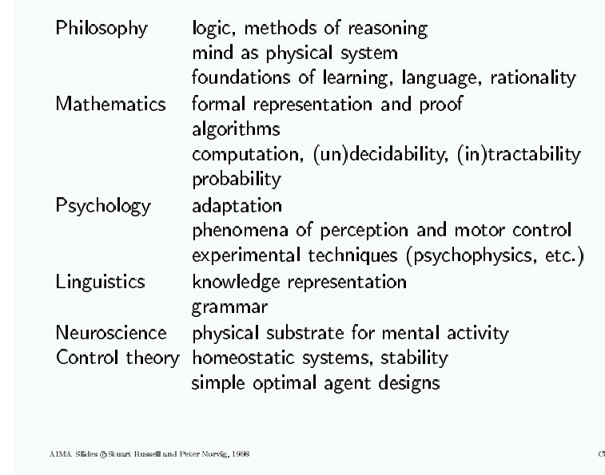
AI Prehistory

Slide 27
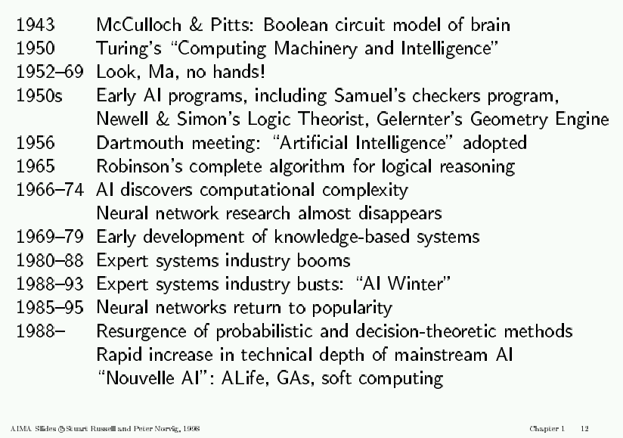
AI History

Slide 28
AI State of the art
Have the following been achieved by AI?
World-class chess playing
Playing table tennis
Cross-country driving
Solving mathematical problems
Discover and prove mathematical theories
Engage in a meaningful conversation
Understand spoken language
Observe and understand human emotions
Express emotions
…

